Slide 1


Analysis of smoking status impact on molecular mechanisms of SARS-CoV-2 viral entry through single-cell sequencing experiments
Author: Mateusz Urbanek
Supervisor: PhD Anna Papież
Notes:
Note: After adding your pictures, right click on it and “Send To Back”.

Slide 2

01
Introduction
What is Single Cell data, and why is it important?
02
Research background and motivation
What is the impact of smoker’s status on SARS-COV-2
Table of contents
03
Workflow methodology
How do we approach analysis of Single Cell Data
04
Discussion
Time for question

Slide 3
01
Introduction
What is Single Cell data, and why is it important?
Notes:
Note: After adding your pictures, right click on it and “Send To Back”.

Slide 4
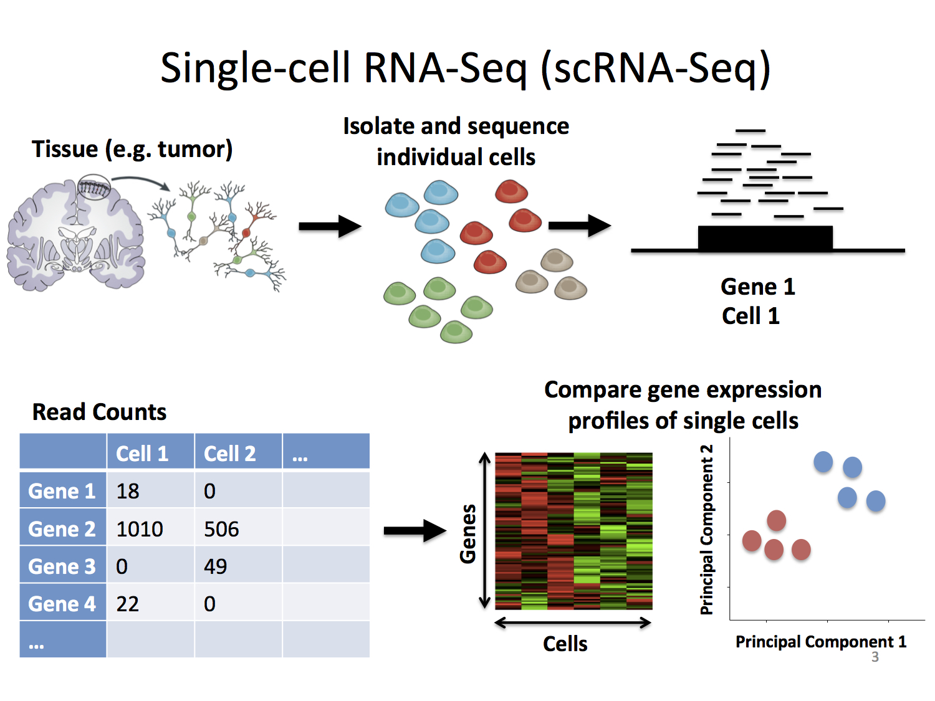
01 - Introduction
Single Cell RNA-seq
RNA sequencing (RNA-seq) - genomic approach for the detection and quantitative analysis of messenger RNA molecules in a biological sample and is useful for studying cellular responses.
Single Cell RNA sequencing (scRNA-seq) - cell are sorted then RNA-seq is performed on specific cell types separately.
Stephanie Hicks Welcome to the World of Single-Cell RNA-Sequencing https://speakerdeck.com/stephaniehicks/welcome-to-the-world-of-single-cell-rna-sequencing?slide=3

Slide 5
02
Research background and motivation
What is the impact of smoker’s status on SARS-COV-2

Slide 6
02 - Research background
Hello world
Hello world

Slide 7
03
Workflow
How do we approach analysis of Single Cell Data

Slide 8
03 - Workflow
Tools
Base tools:
R programming language – base for performing most of the analysis and visualization
Seurat library – default library used for managing Single Cell data
GaMRed – information filtering, Gaussian mixture decomposition, high throughput biological data
Auxiliary tools:
Python –simple prototyping, quick data exploration and data gathering
Bash – data stream edition, building pipelines and fast scripts for data exploration

Slide 9
03 - Workflow
Part 1 – Data loading
Reading count matrices
Calculating percentage for Ribosomal and Mitochondrial RNA
Calculating basic metrices – standard deviation, quantiles, mean, median, etc.
Visualization of basic QC metrics – number of features, counts, RB and MT RNA percentage

Slide 10
03 - Workflow
Part 2 – Data normalization and scaling
Calculating variance for each cell
Performing logarithmic normalization on the data
Calculating the threshold for selection of Variable Features (Gaussian Mixture Models)
Scaling the data
Plotting Variable features

Slide 11
03 - Workflow
Part 3 – Dimensionality Reduction
Dimensionality reduction with multiple methods
Determination of the dimensionality using JackStraw algorithm

Slide 12
03 - Workflow
Part 4 – Clustering
Clustering the cells
Plotting clusters on reduced dimensions
Assigning cell type identity to clusters

Slide 13
03 - Workflow
Part 4 – Clustering – visualization on PCA

Slide 14
03 - Workflow
Part 4 – Clustering – visualization on tSNE

Slide 15
03 - Workflow
Part 4 – Clustering – visualization on UMAP

Slide 16
03 - Workflow
Part 5 – Additional visualization
Heatmaps
Violin plots
Feature Plots

Slide 17
04
Discussion
Time for questions

